Slide 1
CSx283: Connecting LANs

Slide 2
CONNECTING DEVICES
We divide connecting devices into five different categories based on the layer in which they operate in a network.
Connecting devices:
Hubs Bridges
Two-Layer Switches
Routers
Three-Layer Switches
Gateways

Slide 3
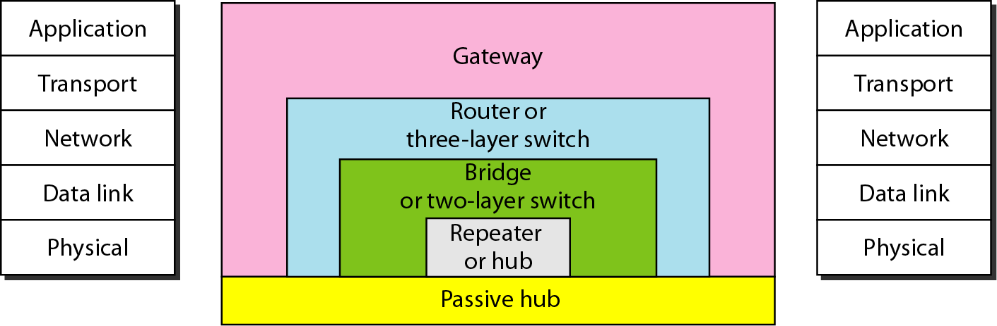
Five categories of connecting devices
Repeaters and hubs operate in the first layer (Physical layer)
Bridges operate in the first two layers (Physical layer and data link layer)
Switches operate in the first two layers (L2 switch) or first three layers (L3 switch)
Routers operate in the first three layers (Physical, data link and network)
Gateways operate in the all layers in the protocol stack

Slide 4
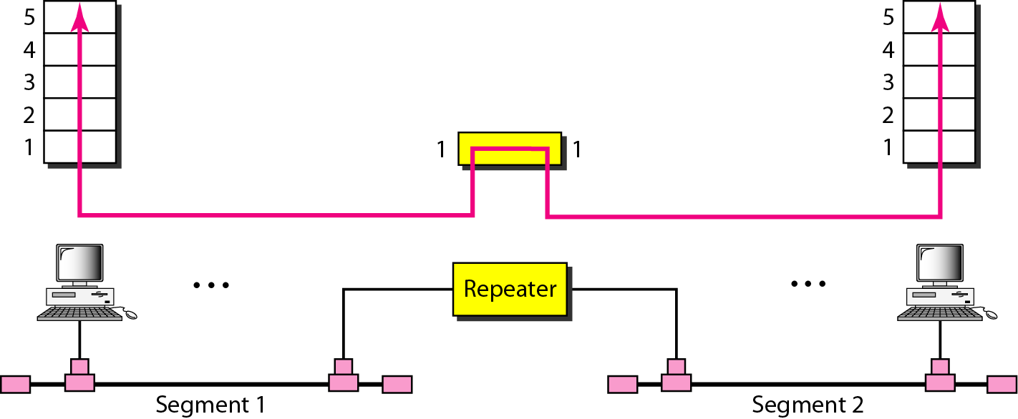
Connecting Devices: Repeater
Repeater - connecting device that operates only in the physical layer:
receive signal on one end →
regenerate original bit patterns →
send refreshed signal on the other end
connects only segments of the same LAN
segments must run the same protocol
has no filtering capability
every frame received will be regenerated (not amplified) and forwarded
location of a repeater is crucial – repeater must be placed so that a signal reaches it before noise changes the meaning of any of its bits

Slide 5

Notes
A repeater connects segments of a LAN.
A repeater forwards every frame; it has no filtering capability.
A repeater is a regenerator, not an amplifier.

Slide 6
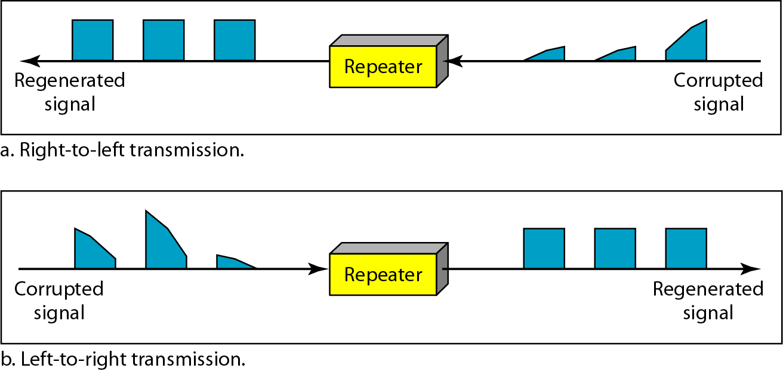
Function of a repeater

Slide 7
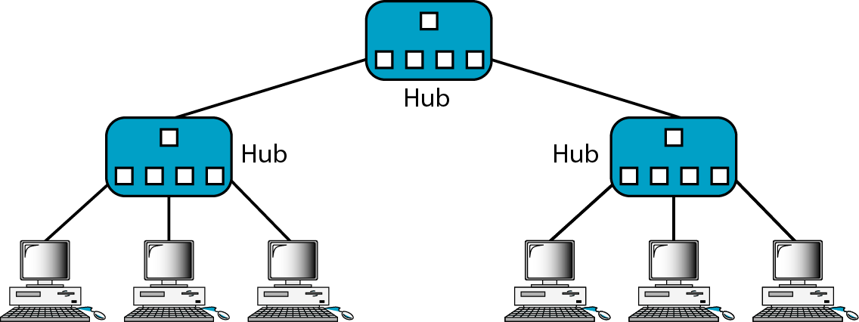
Connecting Devices: Hub
Hub – multiport repeater !!!
receive signal on one end →
regenerate original bit patterns →
send refreshed signal over all other ports
passive hubs: simply send signal to all connected hosts, without amplifying it
active hubs: are connected to electric power source, and are used to refresh the signal sent to all ports

Slide 8
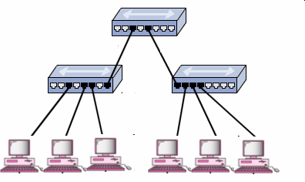
Connecting Devices: Hub
Unnecessary frame flooding in LANs with hubs ]
If node A sends a frame to node B, hubs H₁, H₂, and H₃ forward the frame to all possible location.
H2, and H3 do not have built-in logic to know that A and B are on the same LAN and connected to the same hub, and that repeating the frame is pointless.
H₂
H₁
H₃
A
B
The problem of frame flooding can be resolved by filtering out (not forwarding) frames that have both ‘source’ and ‘destination’ address on the same LAN.

Slide 9
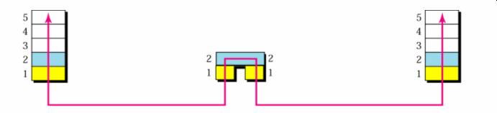
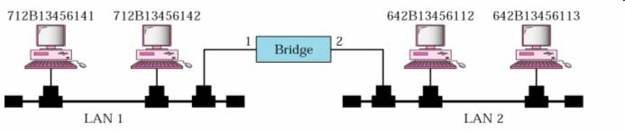
Connecting Devices: Bridge
Bridge – connecting device that operates in both physical & data link layer
as a physical-layer device, bridge regenerates the signal it receives
as a data link layer device, bridge checks physical / MAC addresses (both source and destination) in frames
if frame sent in LAN 1 is destined for a device on LAN 2 – receive and forward the frame; otherwise ignore the frame
to be able to properly forward / filter frames, bridge must build / learn a ‘forwarding table’

Slide 10
Note
A bridge has a table used in filtering decisions.

Slide 11
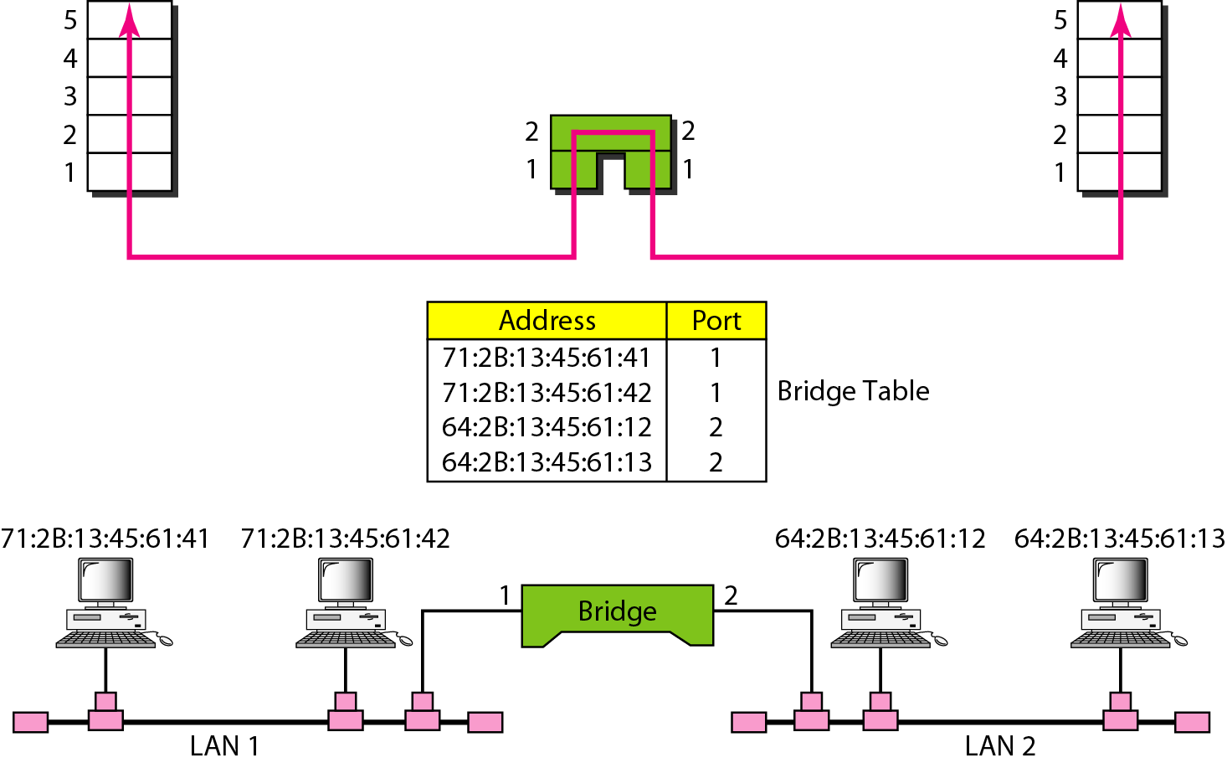
Connecting Devices: Bridge (Filtering Example)
Assume the bridge has a table that maps addresses to ports, i.e. maps the address of each host to the bridge port # through which frames from the given host arrive.
If a frame destined for station 71:2B:13:45:61:42 arrives at port 1, the bridge consults its table to find the departing port. As frames for 71:2B:13:45:61:42 leave through port 1, there is no need for frame forwarding.

Slide 12
Connecting Devices: Bridge (Bridge Learning)
static forwarding tables – earliest bridges used static forwarding tables
system administrators would manually enter each table entry
simple but impractical process – whenever a new station was added or removed, the table had to be modified manually
dynamic forwarding tables – bridge learns the location of all stations gradually, as it operates, and builds forwarding table automatically
learning process: bridge inspects both source and destination address of each received frame
source address is compared with each entry in table
if a match is not found, add source address together with port number on which frame was received to table
if a match is found, do nothing
destination address is compared with each entry in the table
if a match is not found, flood frame on all ports except the one on which the frame was received
if a match is found and port is one on which frame was received, do nothing; otherwise, forward frame to port indicated in table

Slide 13
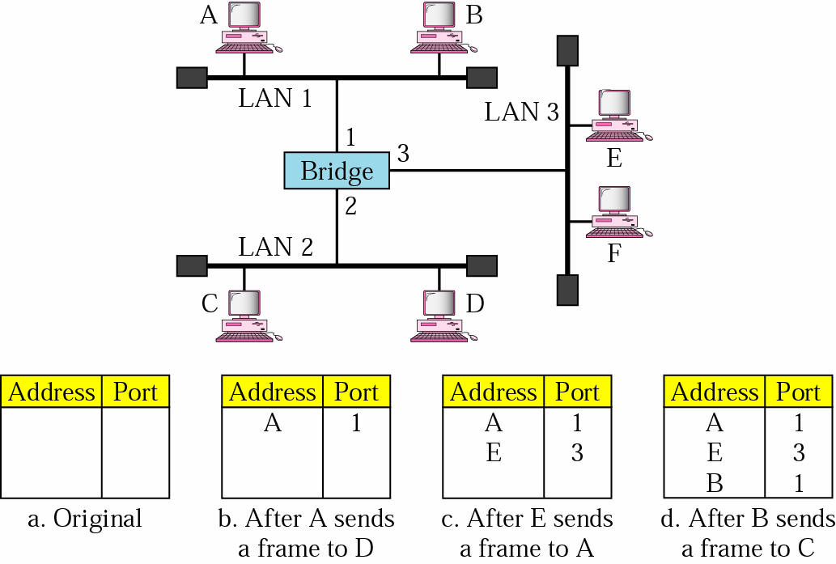
Connecting Devices: Bridge (Bridge Learning)
When station A sends a frame to station D, the bridge does not have any entry for either A or D. Hence,
frame is flooded on ports 2 and 3
by looking at the source address, the bridge learns that station A must be located on the LAN connected to port 1 (LAN 1) ⇒ frames destined for A must be sent out through port 1.
When station E sends a frame to station A, the bridge has an entry for A. Hence
the frame is forwarded only to port 1
the source address of the frame is added as a second entry to the table

Slide 14
Note
A bridge does not change the physical (MAC) addresses in a frame.

Slide 15
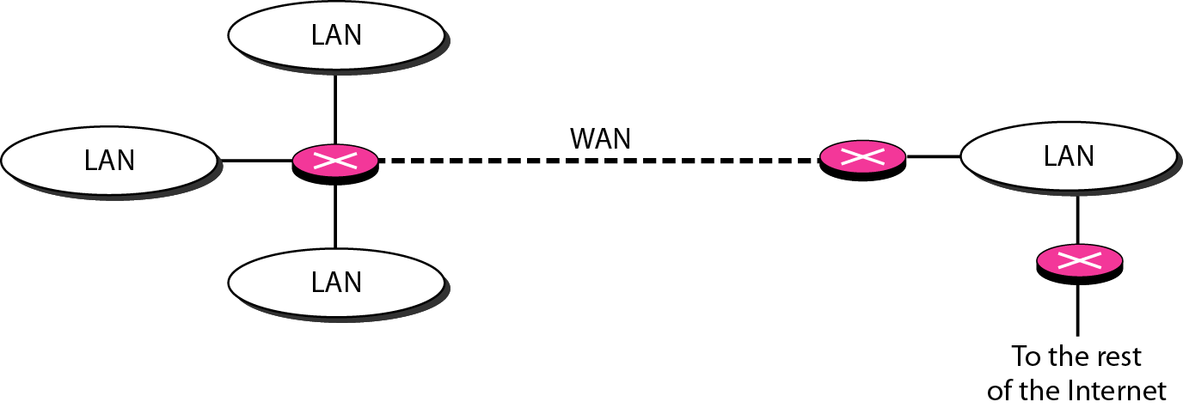
Connecting Devices: Router
Router is mainly a Network Layer device
A router is a device like a switch that routes data packets based on their IP addresses.
Routers normally connect LANs and WANs together
Each routers maintains and updates routing table dynamically, and forwards the packets based on it.

Slide 16
Connecting Devices: Gateway
Gateway works at all the layers of the protocol stack
Connects two (or more) dissimilar networks
Works as protocol converter
Could be a computer

